Slide 1


TECHNICAL UNIVERSITY OF LIBEREC
www.fzs.tul.cz

Slide 2

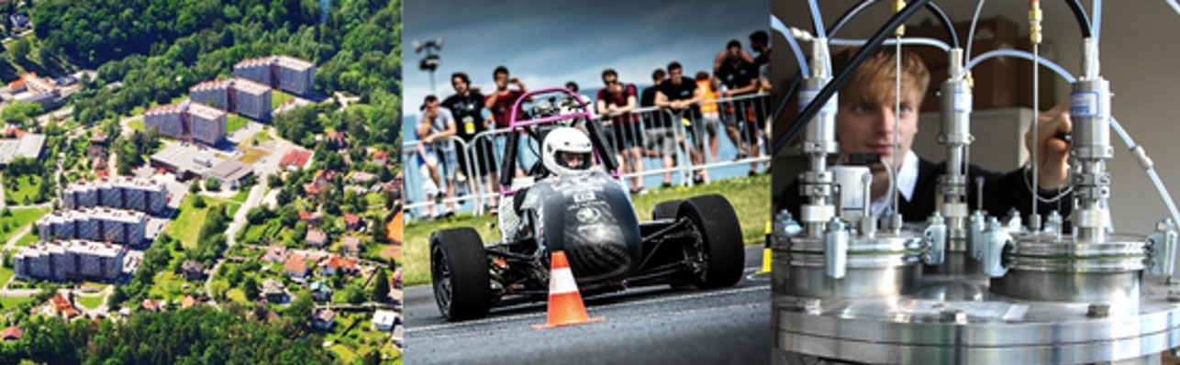

TECHNICAL UNIVERSITY OF LIBEREC
  Established in 1953 and celebrats 70 years in 2023
  Bachelor, Master and Ph.D. study programmes
  Public-financed, research-oriented university
  Medium-sized university with over 1,300 employees
  6,500 students and 35,000 alumni
  12 % international students from 40+ countries

Slide 3
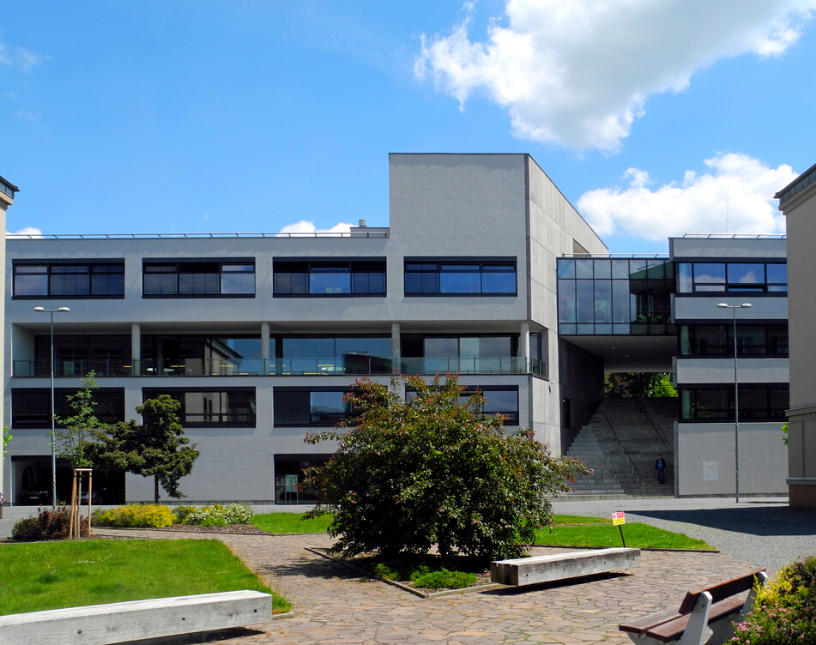
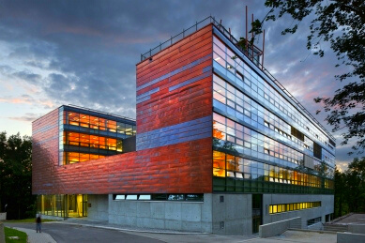
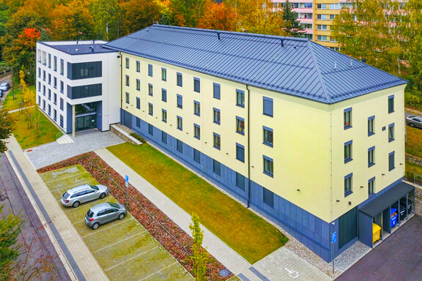
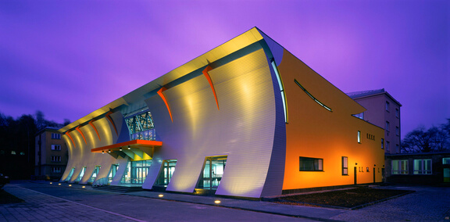
TECHNICAL UNIVERSITY OF LIBEREC
Faculty of Health Studies
Faculty of Mechanical Engineering
Faculty of Textile Engineering
Faculty of Science-Humanities and Education
Faculty of Economics
Faculty of Arts and Architecture
Faculty of Mechatronics Informatics and Inter-Disciplinary Studies
Institute for Nanomaterials, Advanced Technologies and Innovation

Slide 4
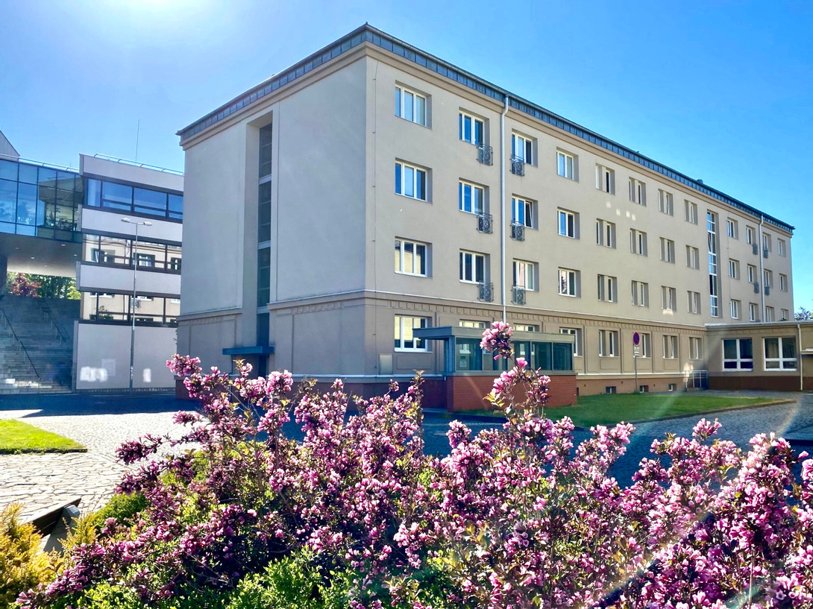
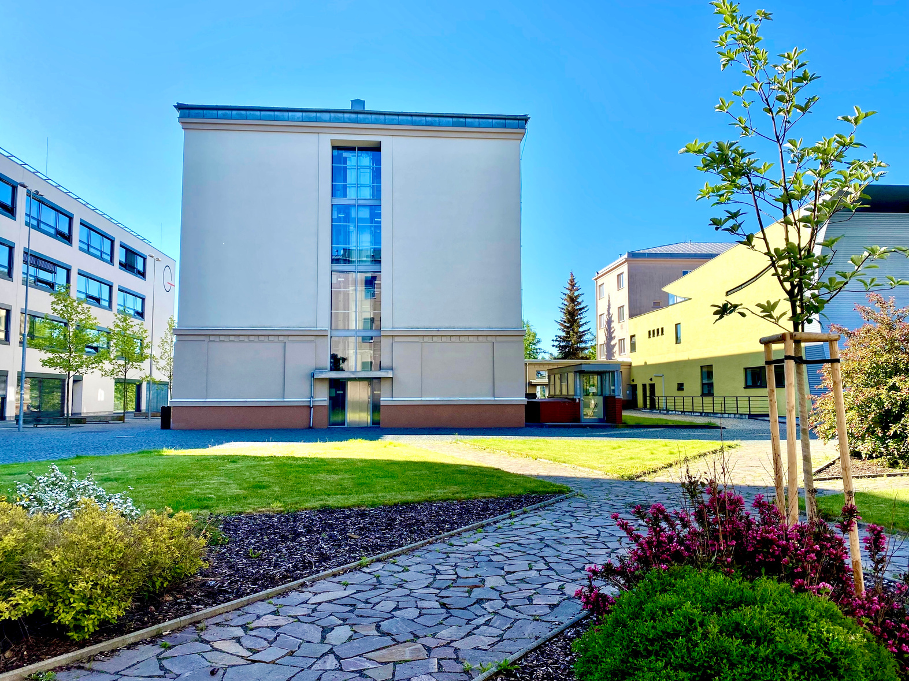

Slide 5
ABOUT US
  Over 400 students in 5 study programmes
  Courses organized in cooperation with renown medical institutions and hospitals
  Internships and training sessions with professionals from hospitals and emergency medical services
  Excellently equipped laboratories

Slide 6
STUDY PROGRAMMES
GENERAL NURSING | BSc.
PARAMEDIC | BSc.
RADIOLOGICAL ASSISTANCE | BSc.
BIOMEDICAL TECHNOLOGY | BSc.
BIOMEDICAL ENGINEERING | MSc.

Slide 7
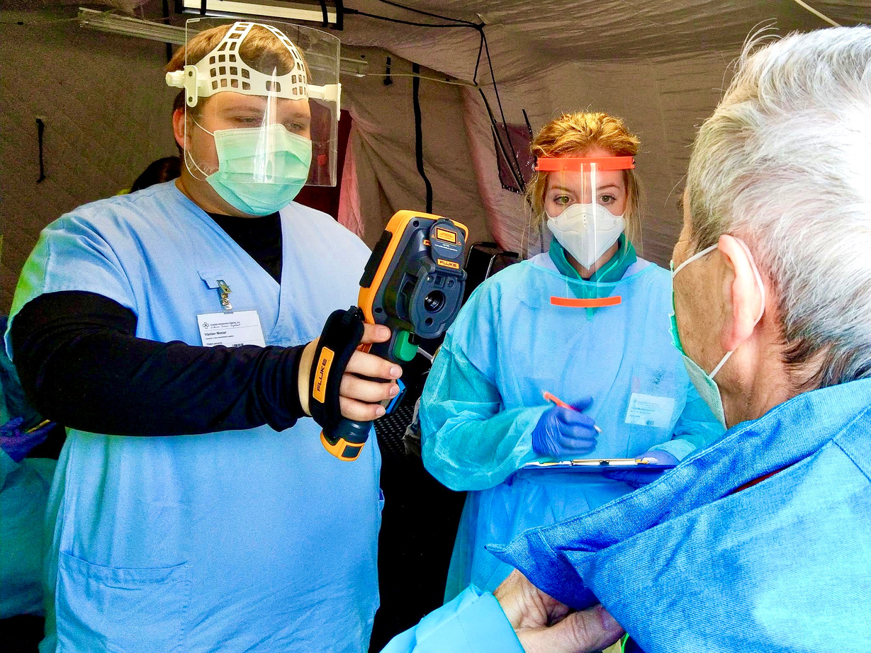
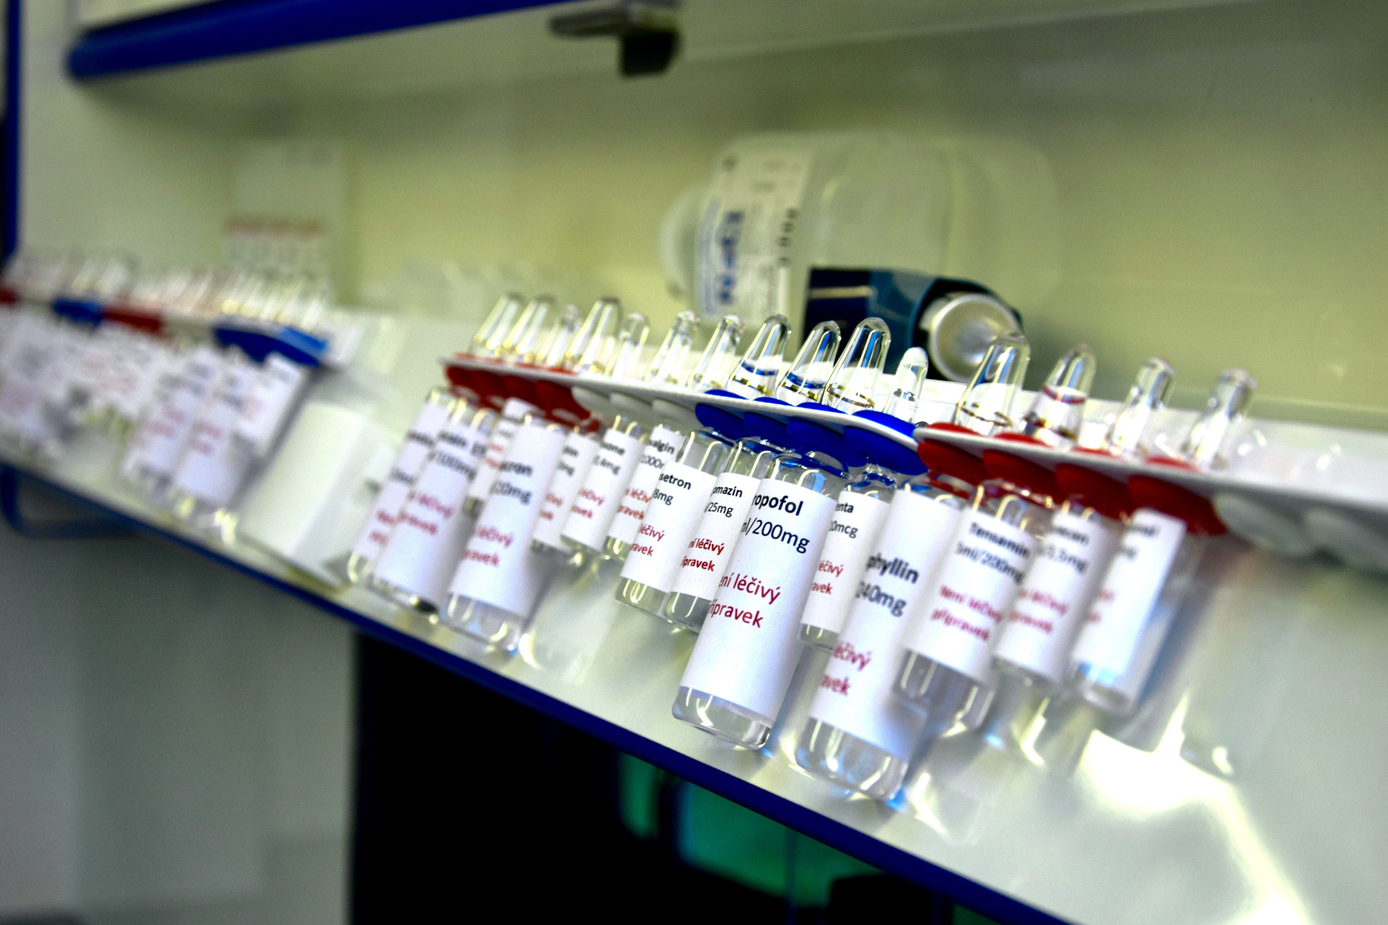
GENERAL NURSING
BSc.

Slide 8

GENERAL NURSING
BSc.
  2320 hours of hospital training
  Cooperation with 60+ medical institutions
  The study is devoted to the applied fields of surgery, internal medicine, paediatrics
  Internships in the specialized departments (proton centre, Institute of clinical and experimental medicine) part of the study
  The theoretical part of the study is lectured by doctors and nurses from the praxis

Slide 9
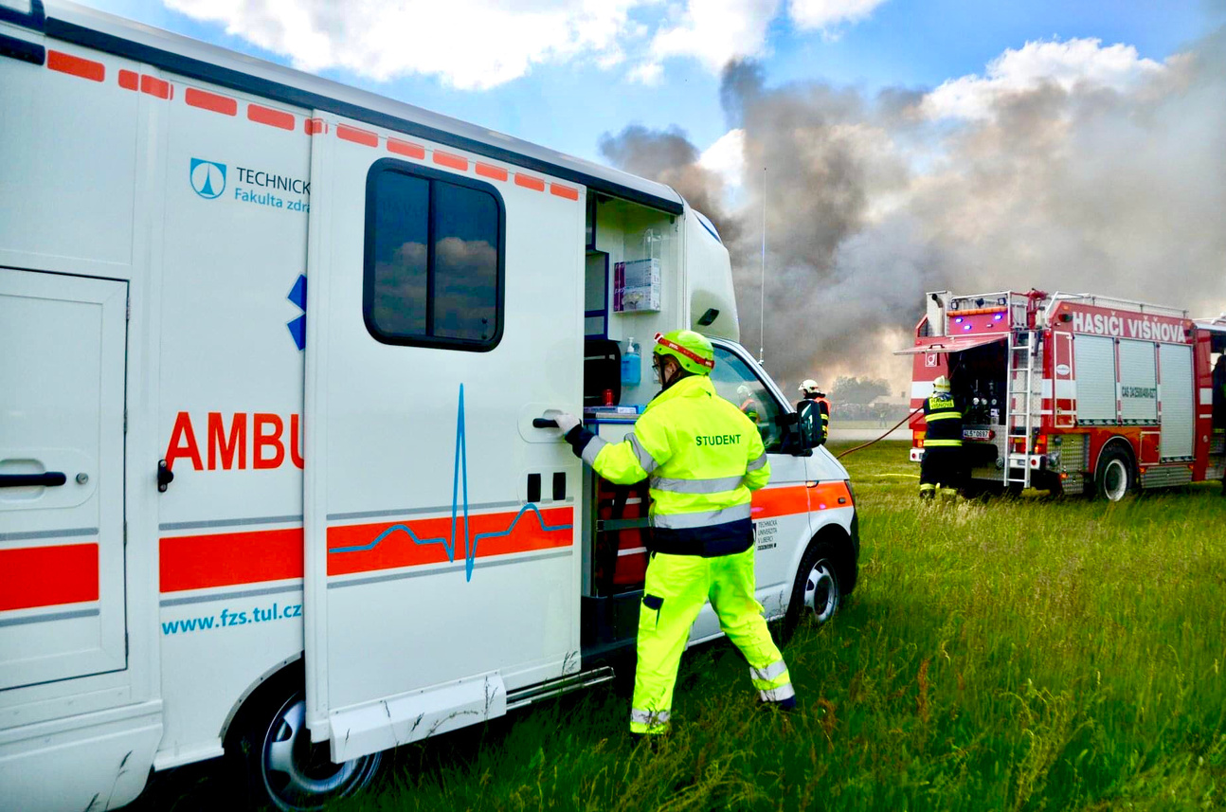
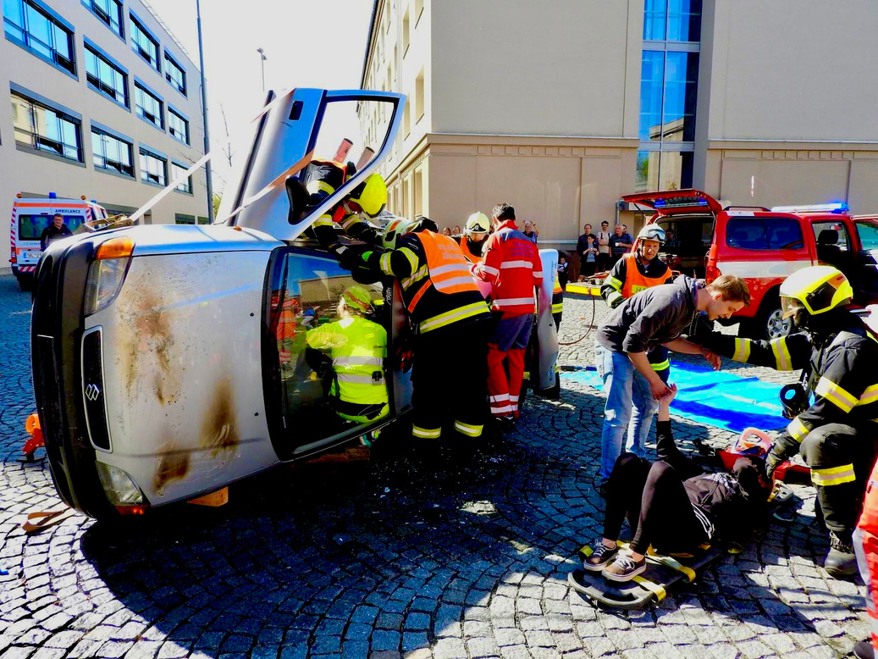
PARAMEDIC
BSc.

Slide 10
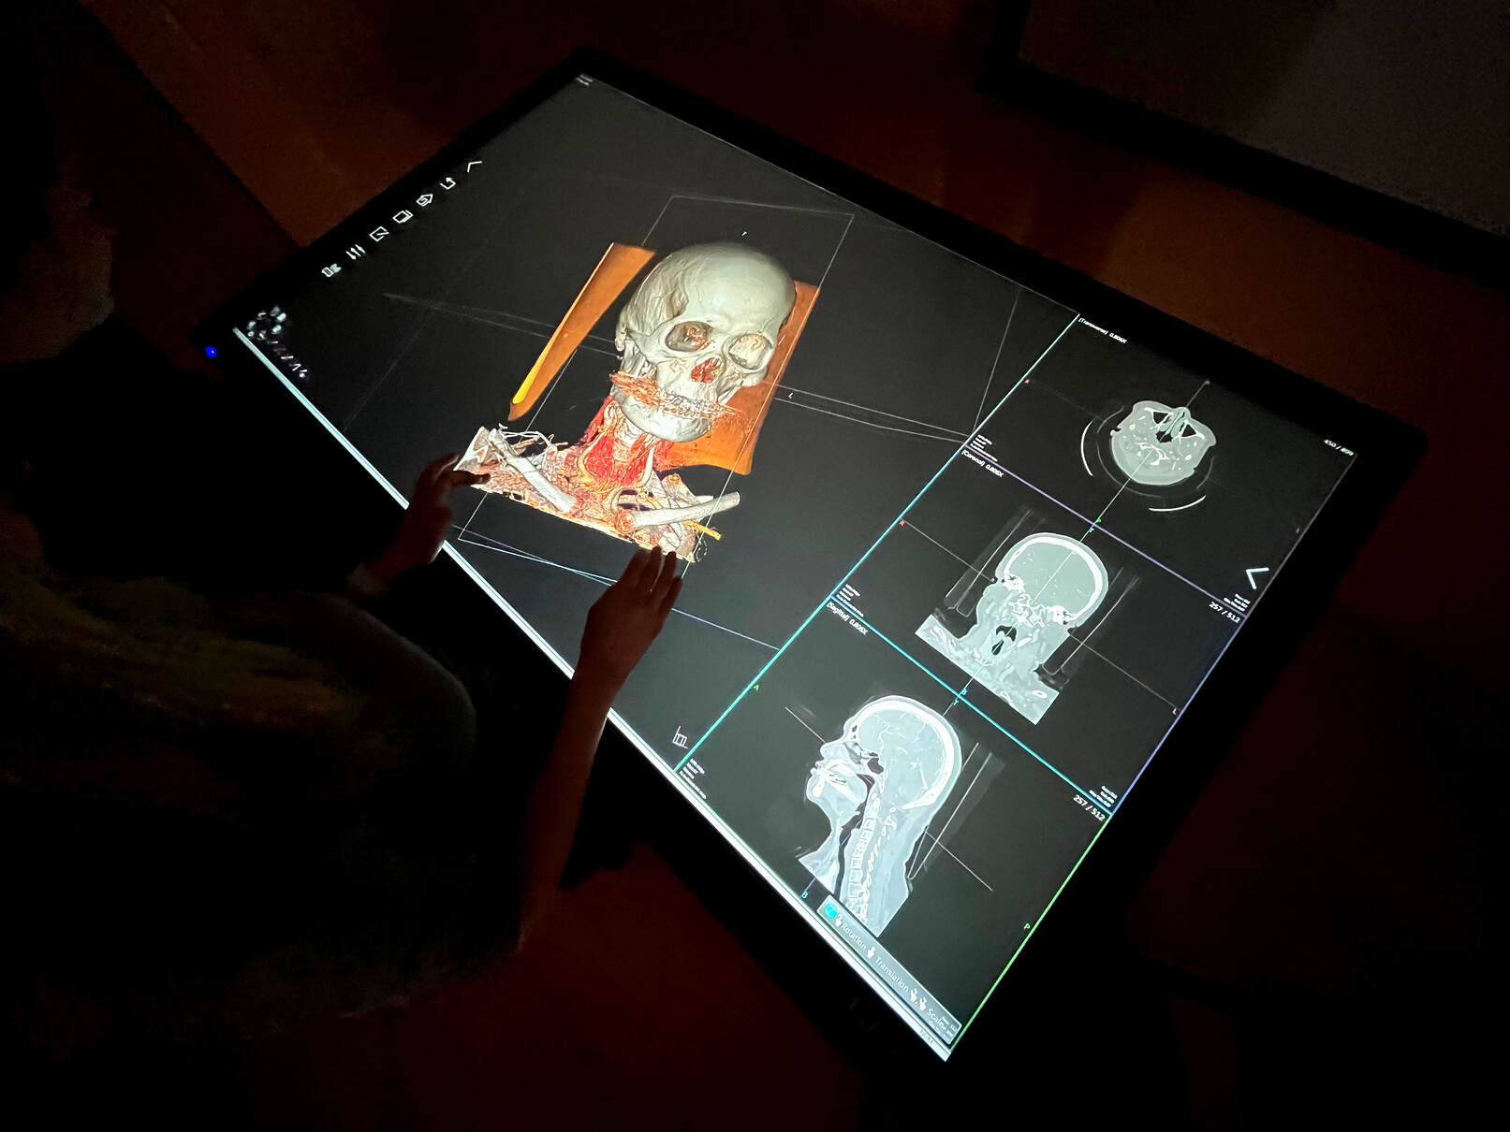
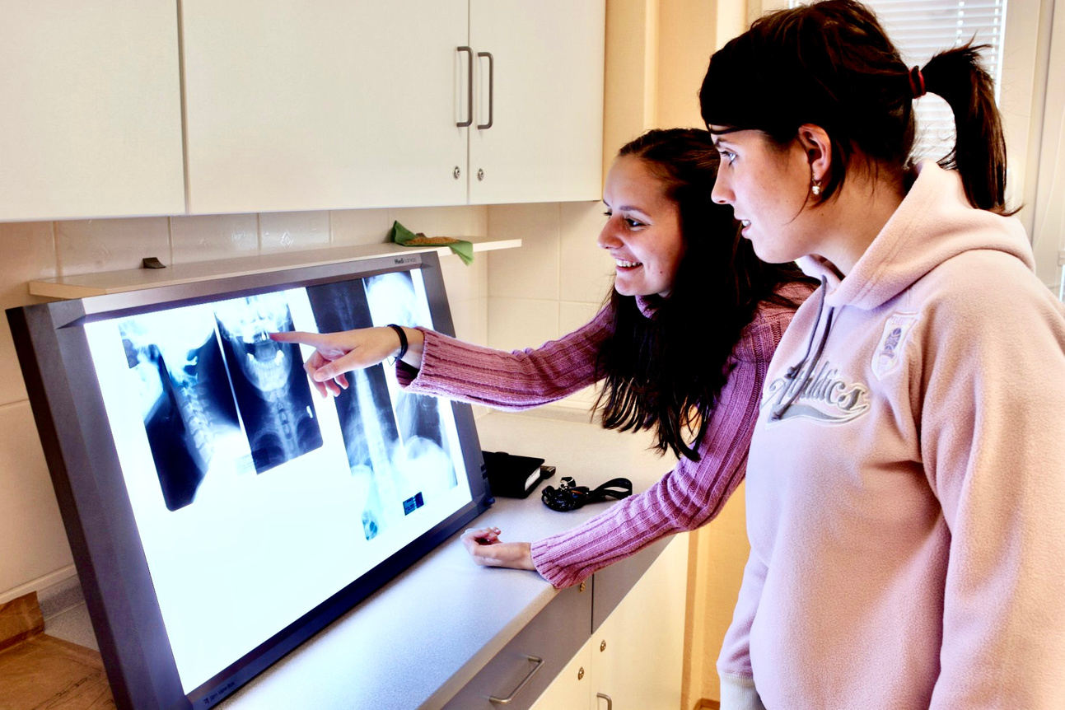
RADIOLOGICAL ASSISTANCE
BSc.

Slide 11
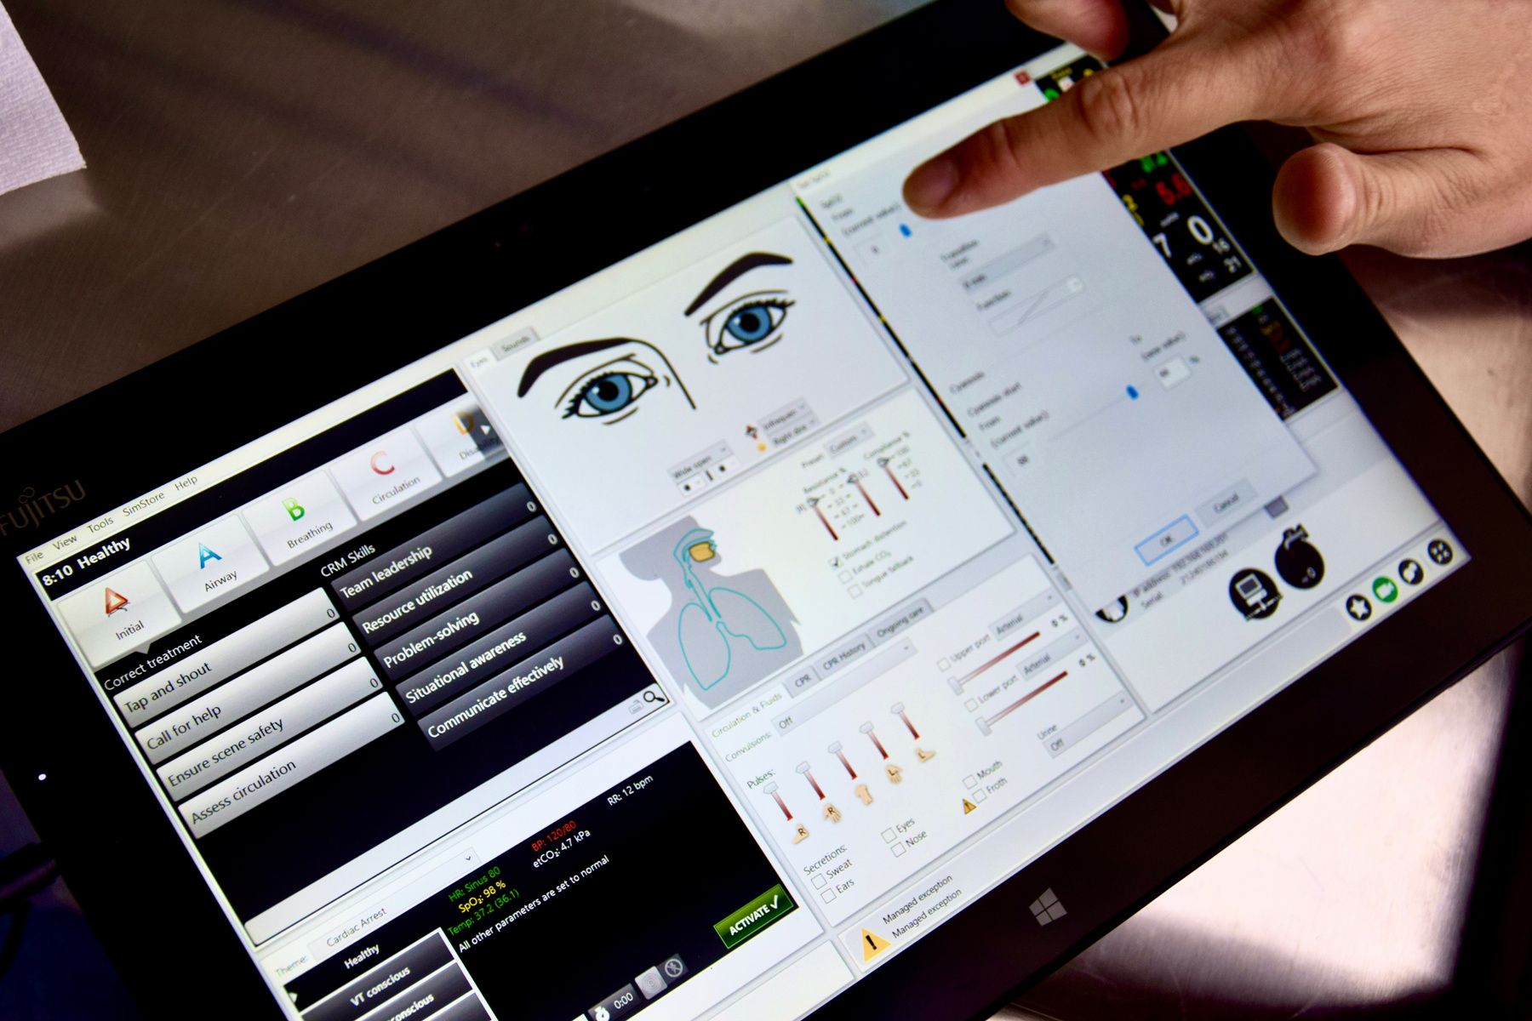
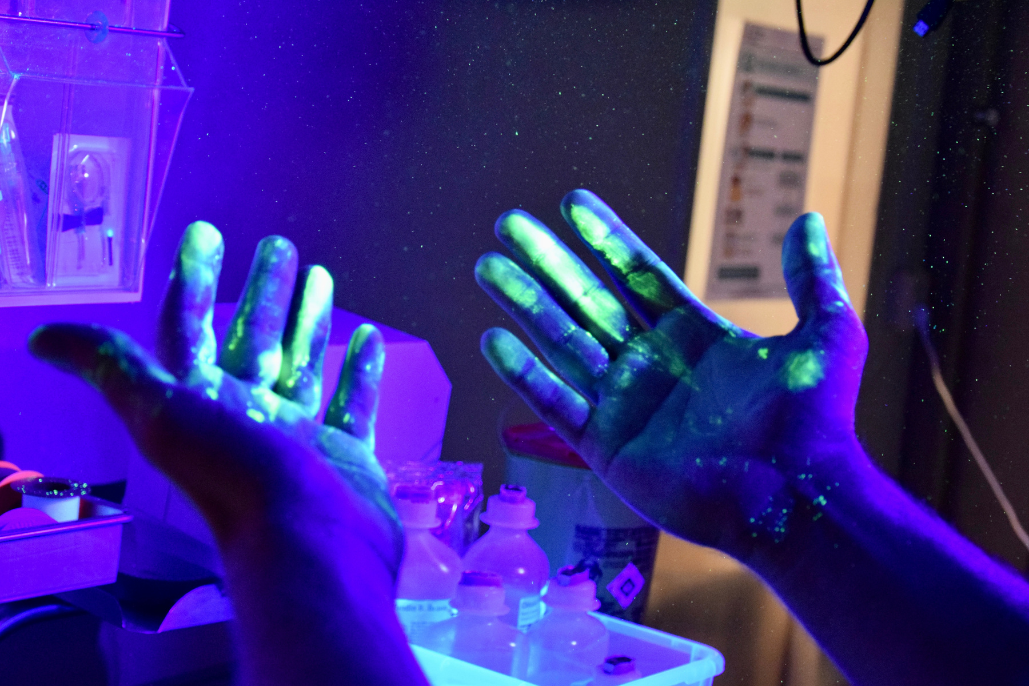
BIOMEDICAL TECHNOLOGY
BSc.

Slide 12
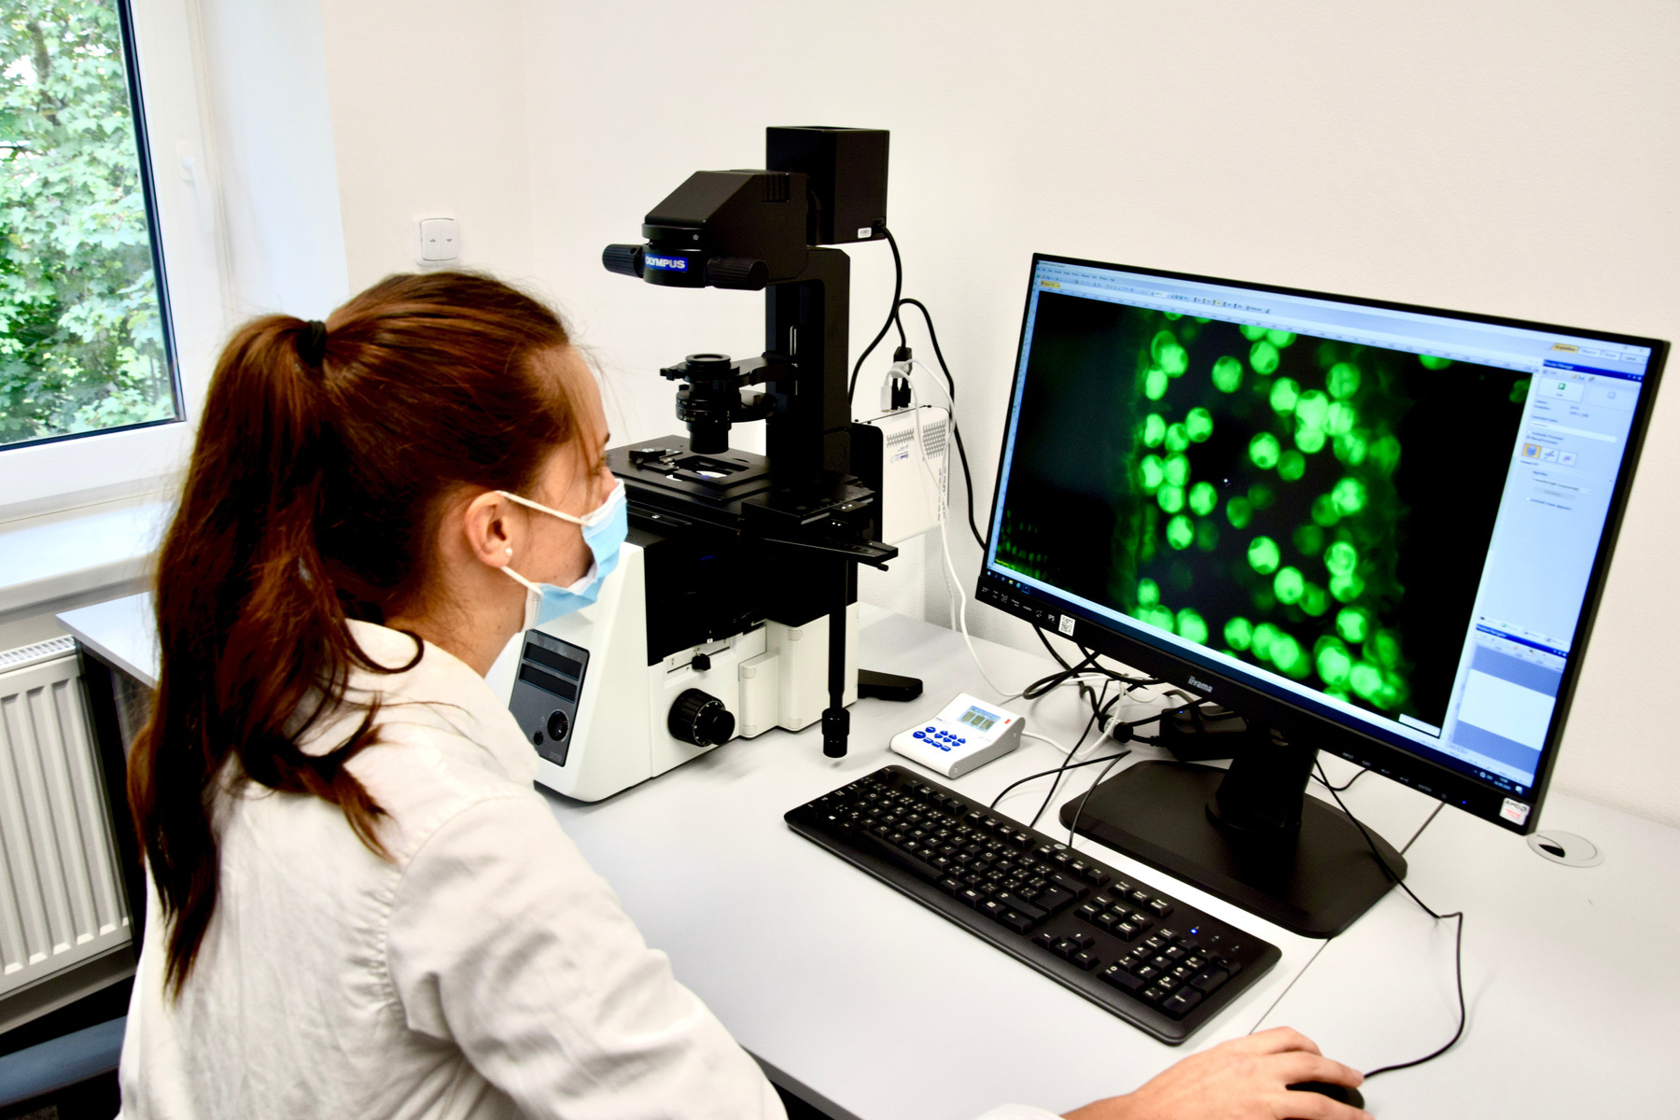
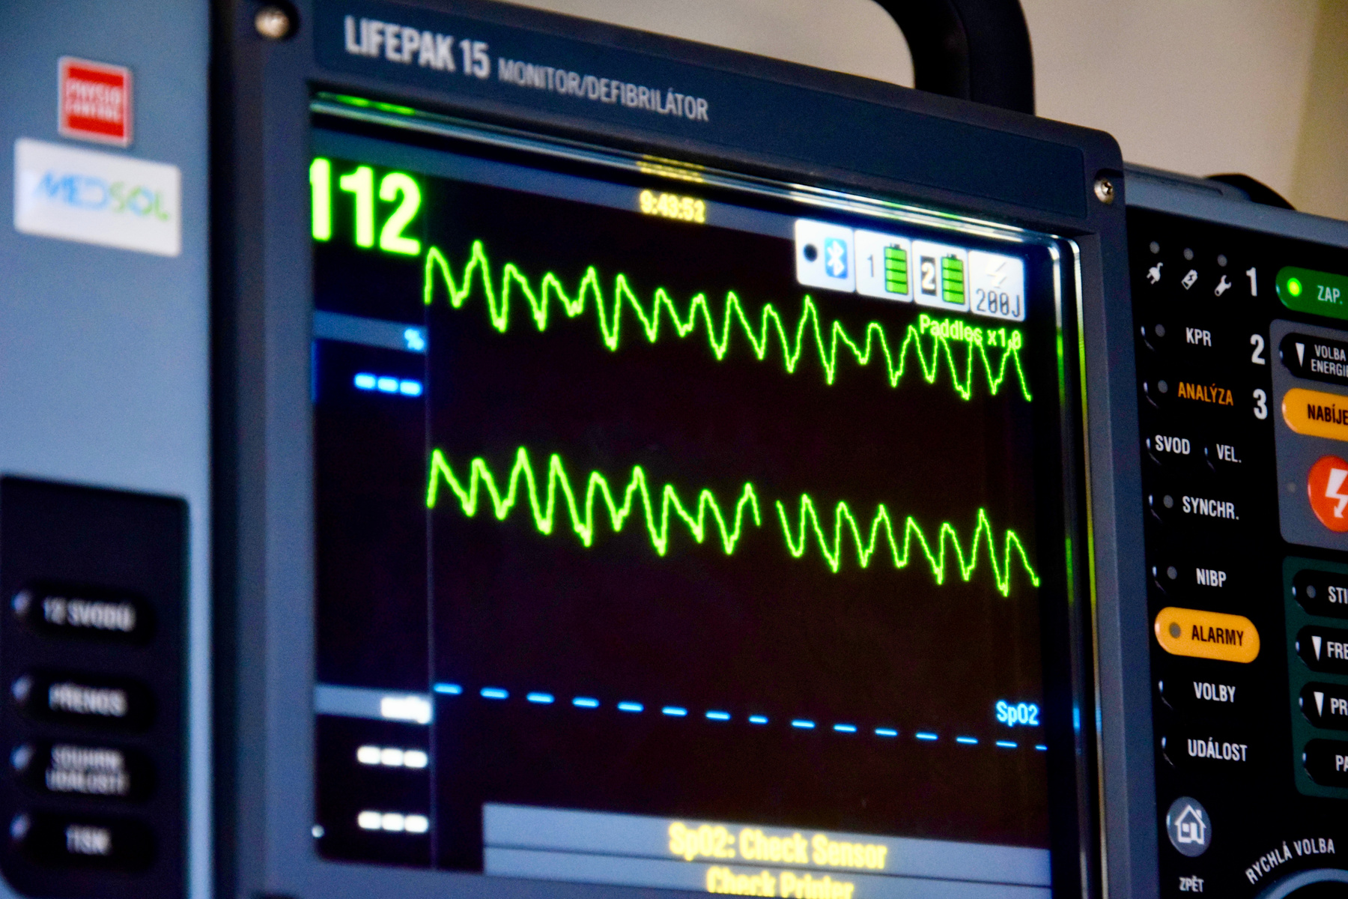
BIOMEDICAL ENGINEERING
MSc.

Slide 13
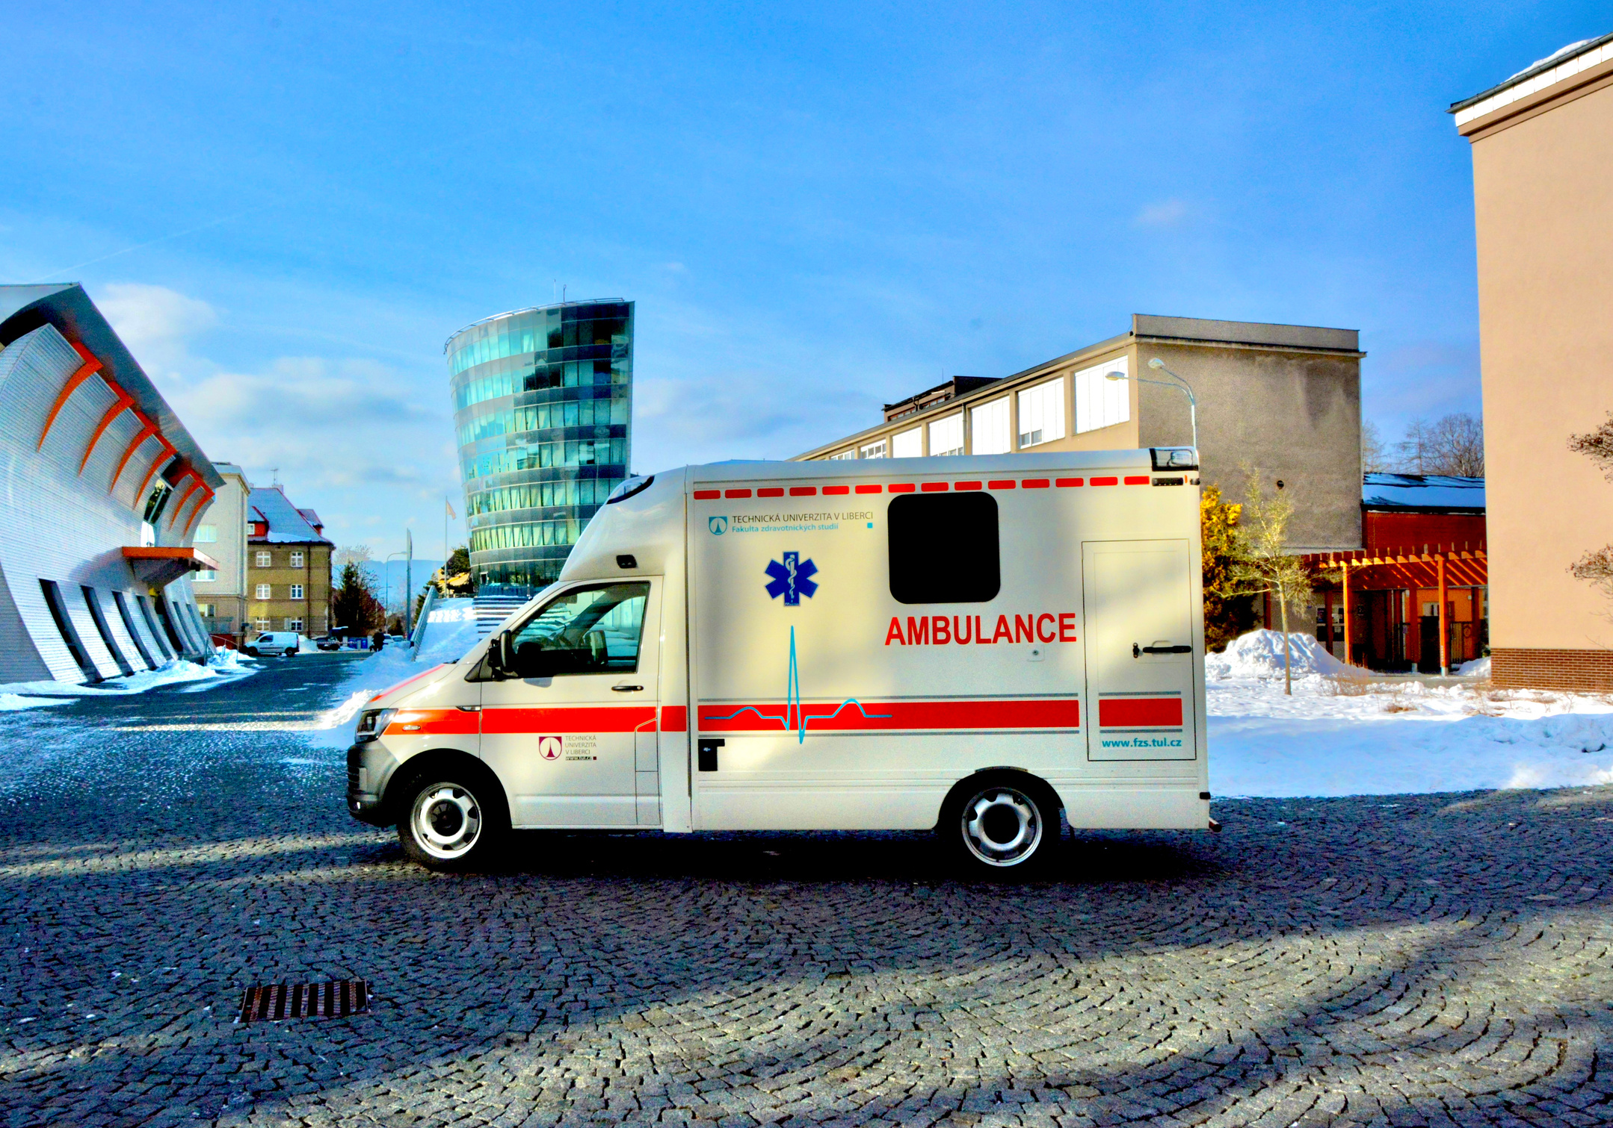
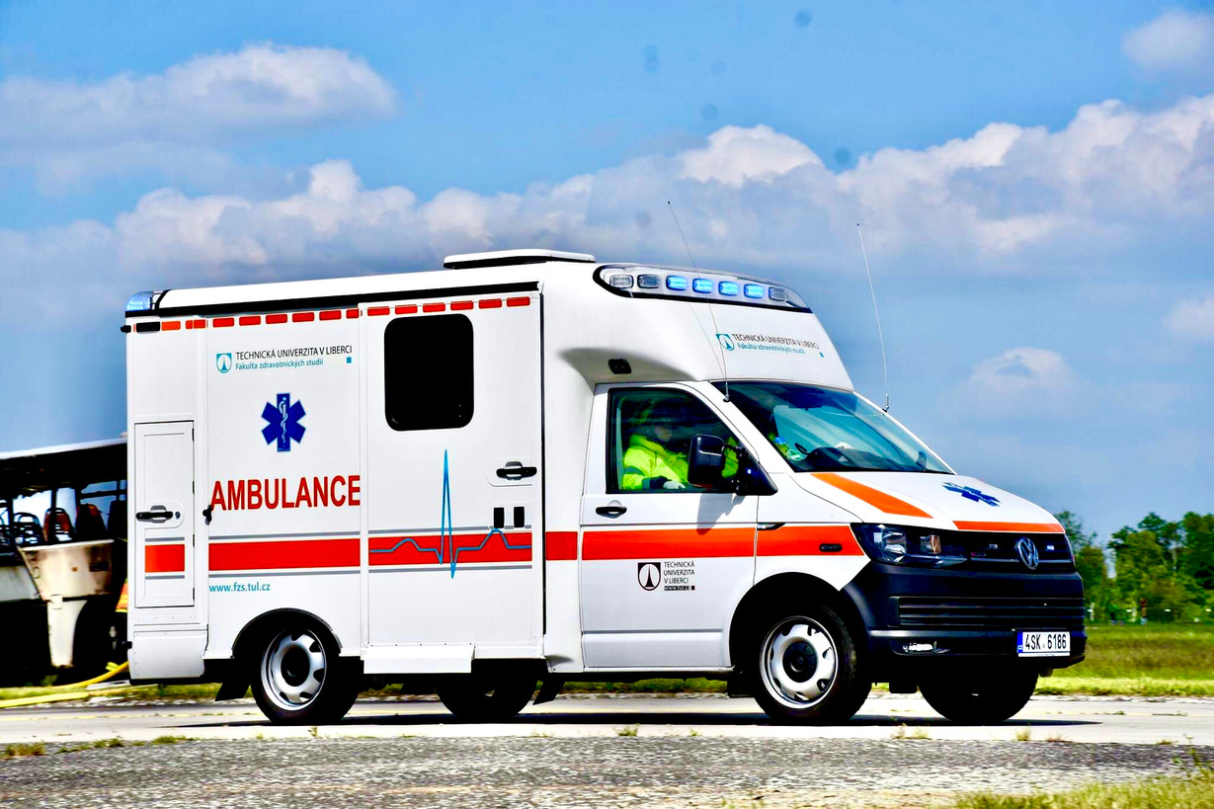
EMERGENCY AMBULANCE

Slide 14
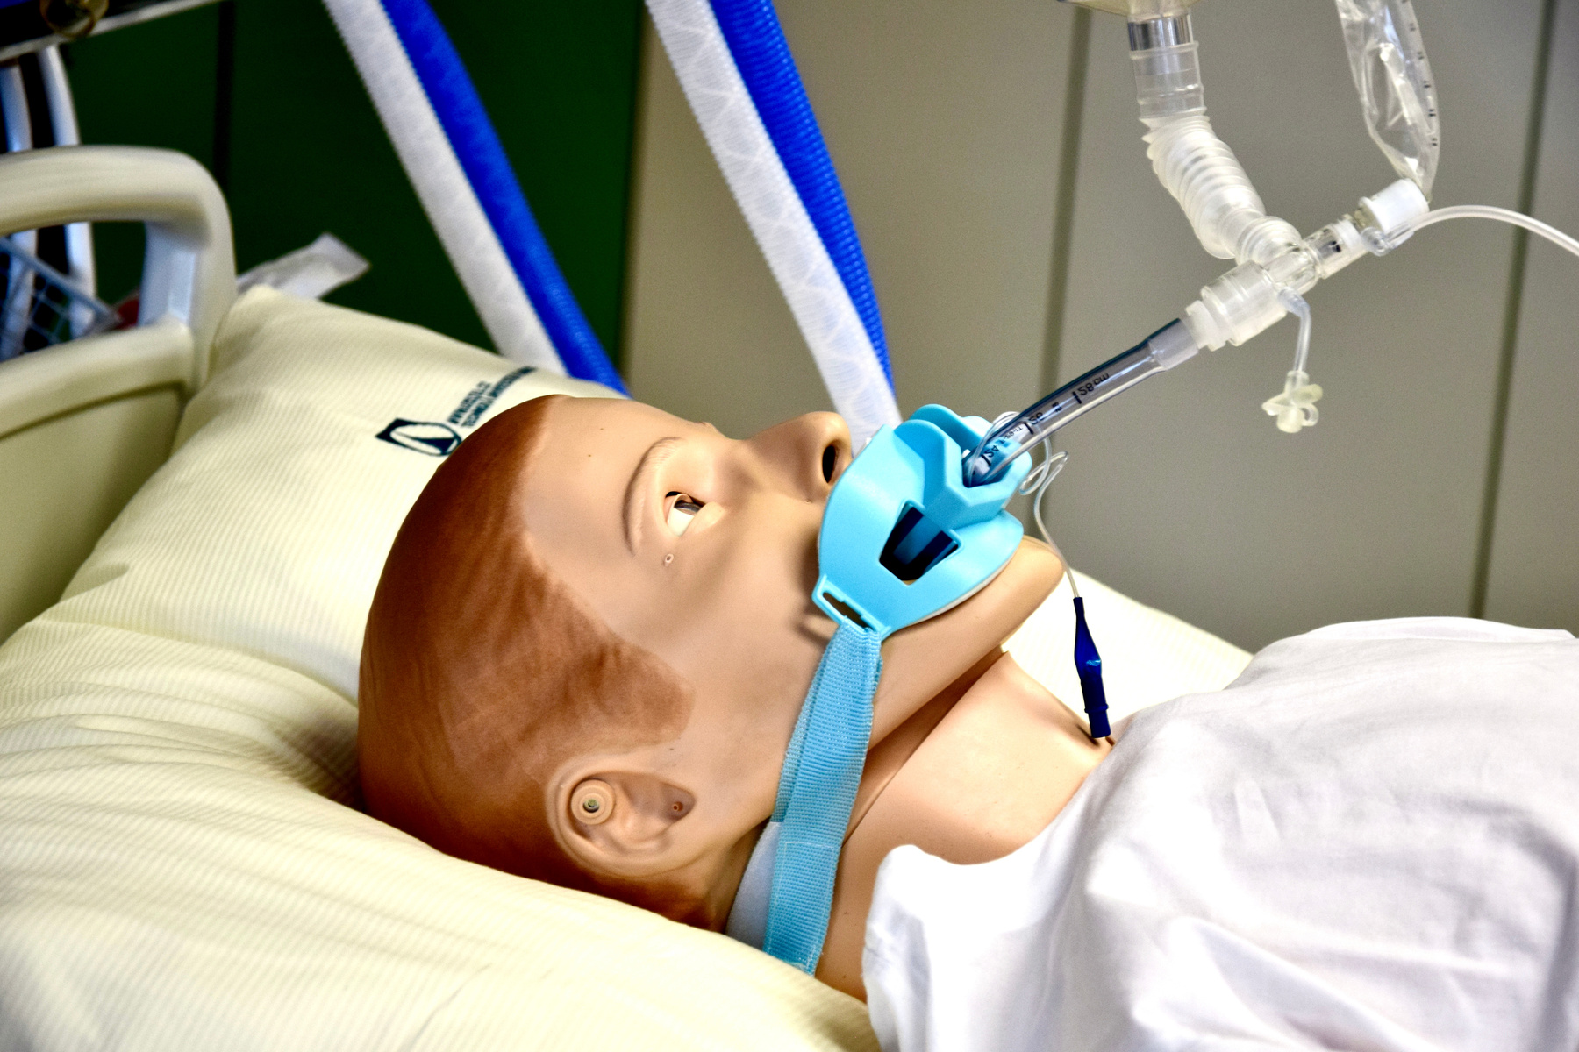
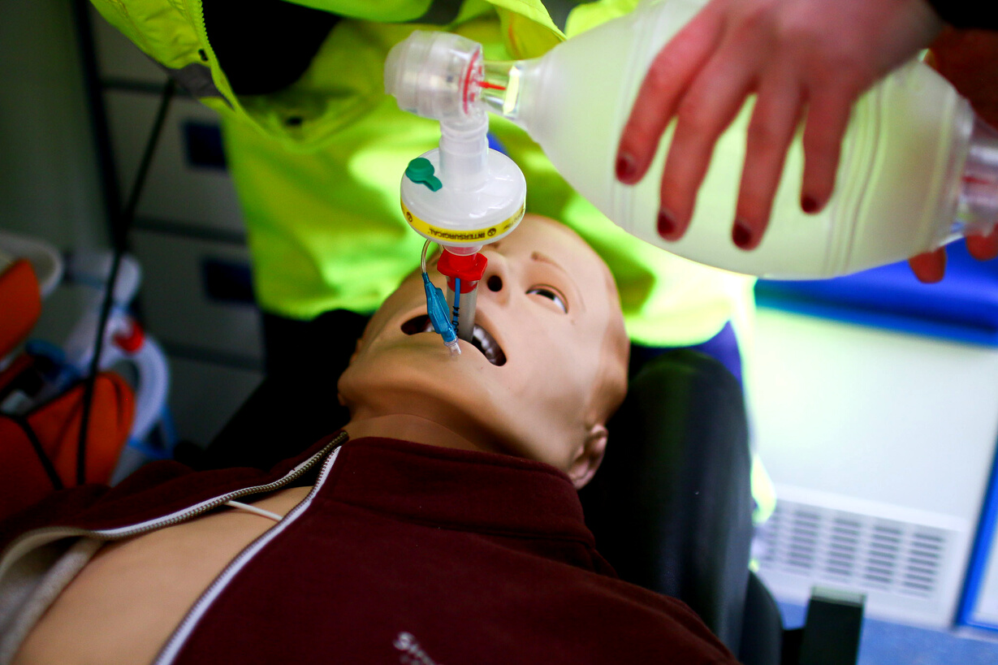
SIMMAN (PACIENT SIMULATORS)

Slide 15
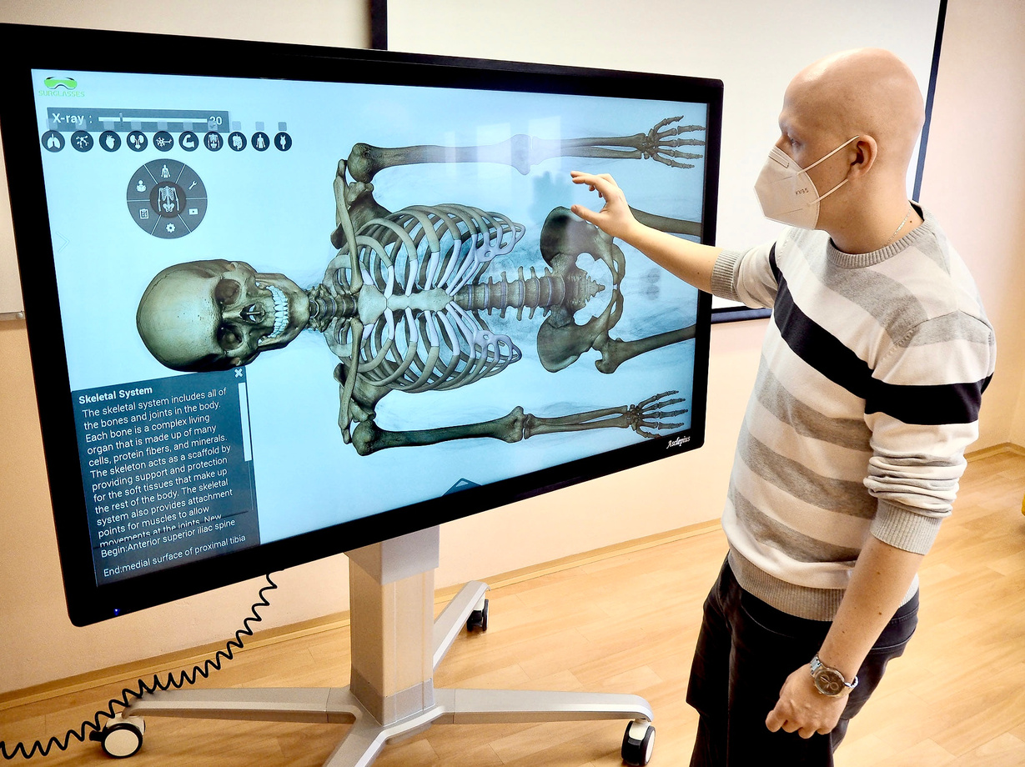
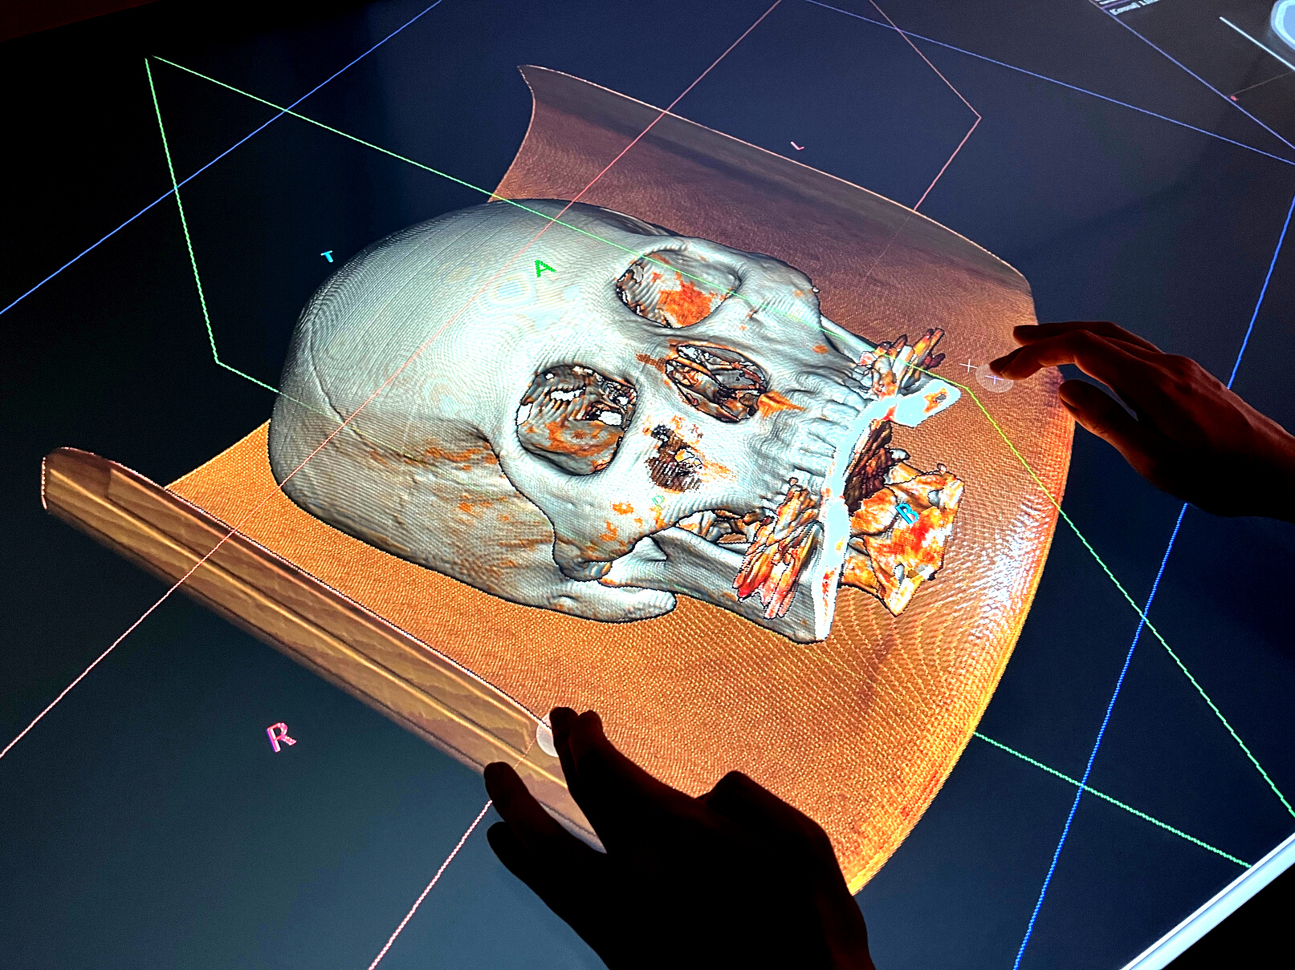
VIRTUAL ANATOMY TABLE

Slide 16
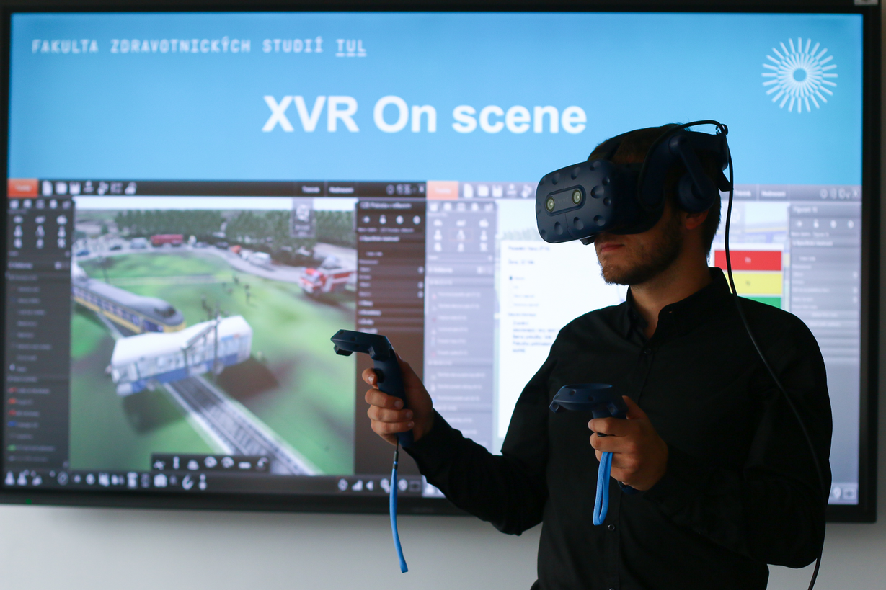
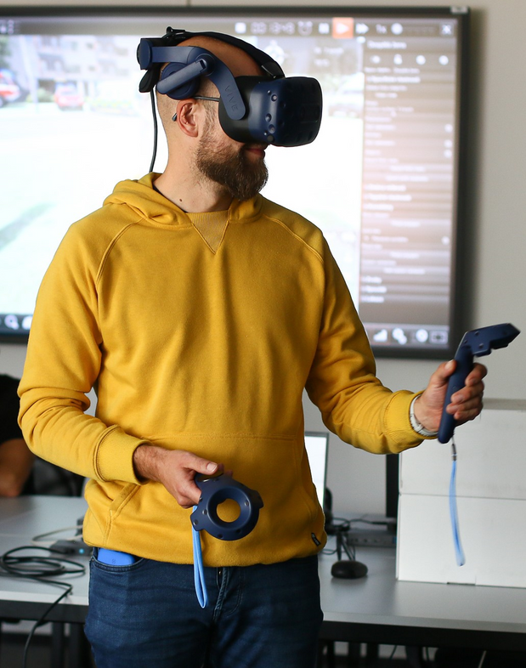

VIRTUAL REALITY

Slide 17
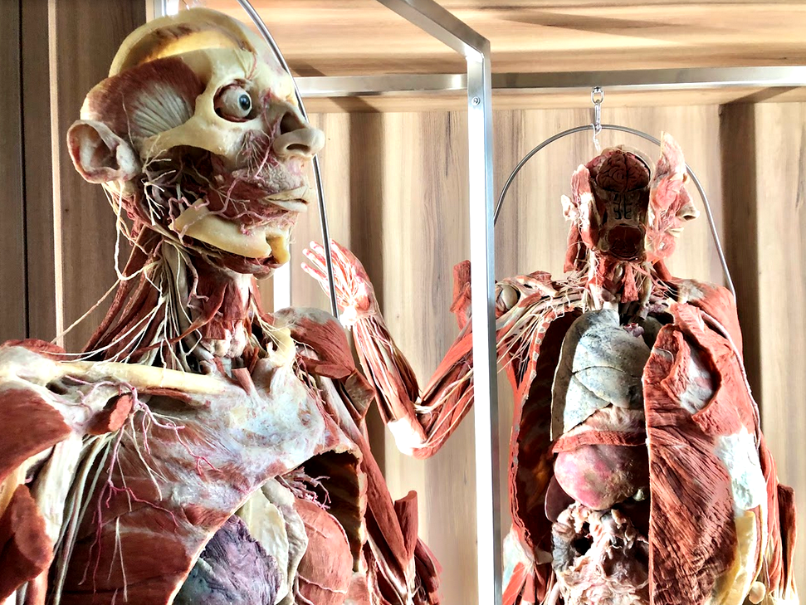
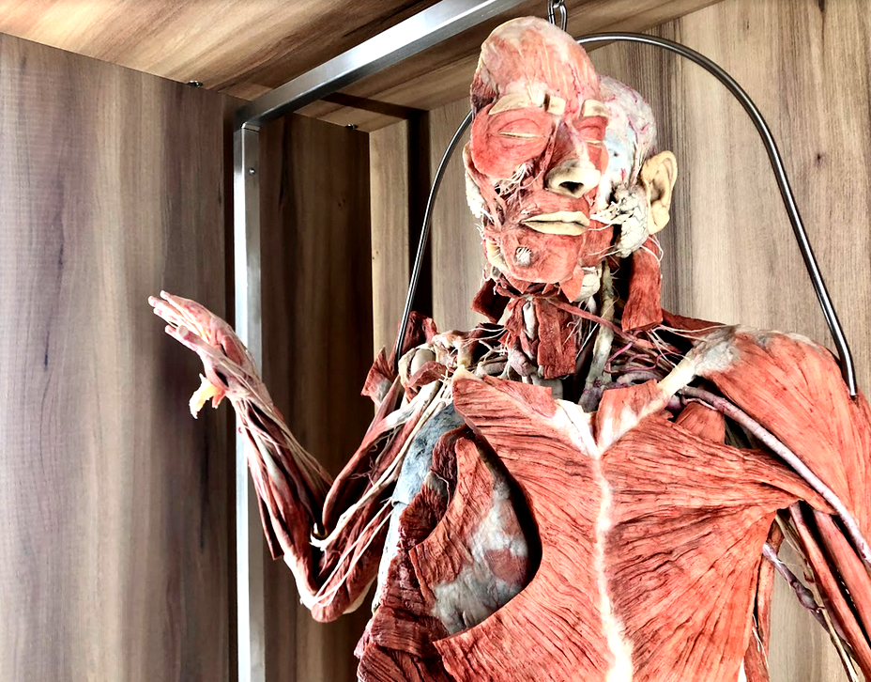
PLASTINATED HUMAN BODIES

Slide 18

FOR EXCHANGE STUDENTS
  Individual study plans
  Excursions in various hospital departments
  Trainings and Internships at the Liberec Regional Hospital

Slide 19
RESEARCH AREAS
  Smart Assistive Systems for Healthcare and Physiotherapy
  Sensor Systems Monitoring Vital Signs
  Analysis of Bone Mineral Density
  Survey of Healthcare Associated Infections
  New Nanomaterials Development and Testing

Slide 20
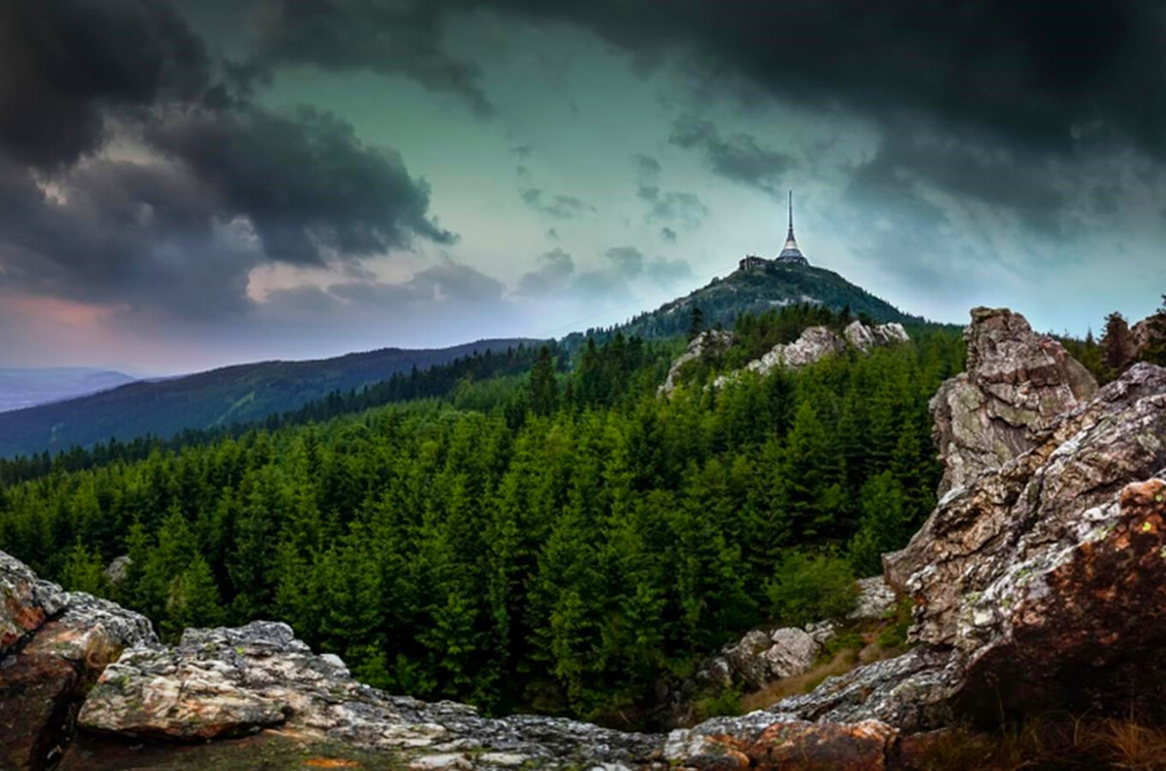
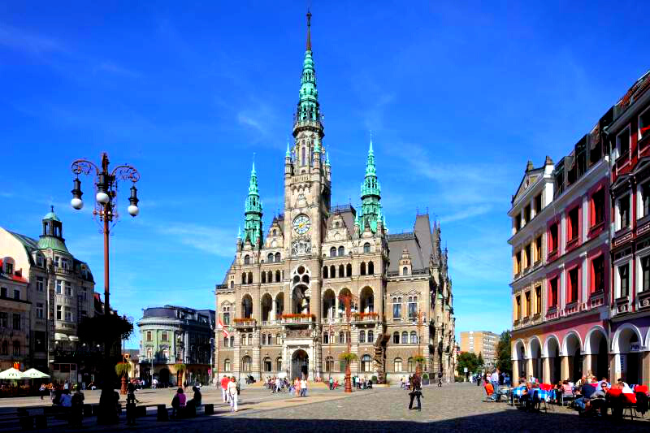
LIBEREC

Slide 21



Faculty of
Health Studies TUL
www.fzs.tul.cz
@fzs.tul

